Slide 1


Pizza Sales Analysis
MS-EXCEL Project - 3
Presented by: Sathishsagar Chanda

Slide 2
Problem Statement
Understanding customer ordering patterns, best-selling pizzas, and peak sales times to optimize sales and inventory management.

Slide 3
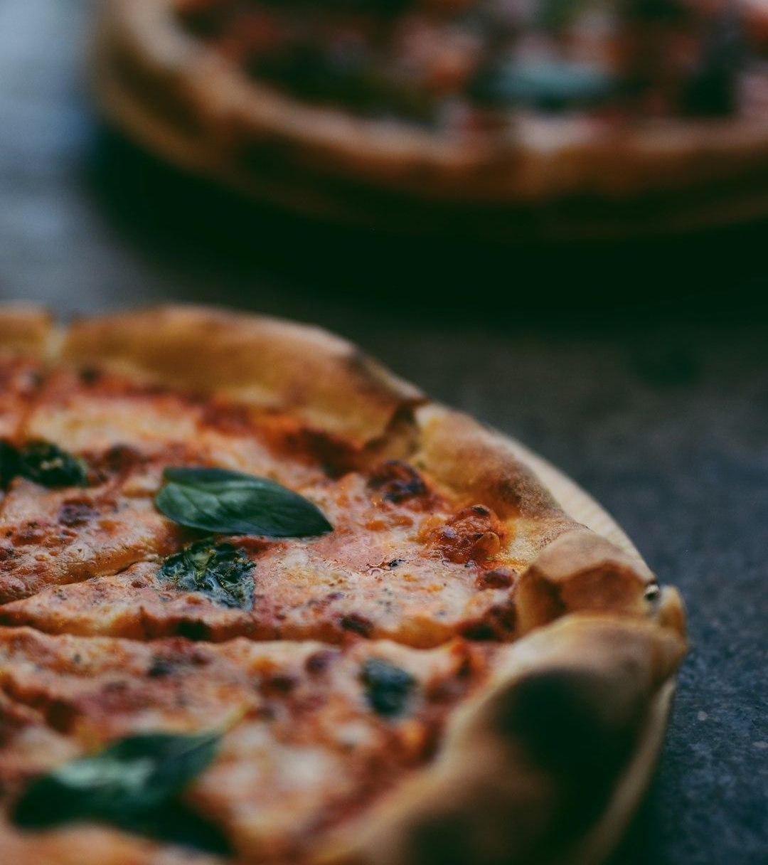
Key Metrics
Total Revenue: $71,402.75
Total Pizzas Sold: 4,328
Average Order Price: $38.53
Total Orders: 1,853
Average Pizzas Per Order: 2.34
Photo: selective focus photography of two pizzas
Photo by shayan ramesht
Powered by Unsplash

Slide 4
Daily Sales Trend
Daily Trend for Total Orders
Sales peak on Fridays and Saturdays.
Lowest sales occur on Tuesdays.
Friday has the highest number of orders (379).
Power BI Dashboard

Slide 5
Hourly Sales Trend
Hourly Trend for Total Orders
Peak ordering hours: 12 PM - 1 PM and 4 PM - 8 PM.
Lowest orders at 10 AM and after 10 PM.
Power BI Dashboard

Slide 6
Sales by Pizza Category
% Sales by Pizza Category
Classic pizzas contribute the most sales (27.2%).
Supreme and Veggie categories follow closely.
Power BI Dashboard

Slide 7
Sales by Pizza Size
% Sales by Pizza Sizes
Large pizzas contribute the highest sales (46.18%).
XX-Large pizzas have the least share (0.15%).
Power BI Dashboard

Slide 8
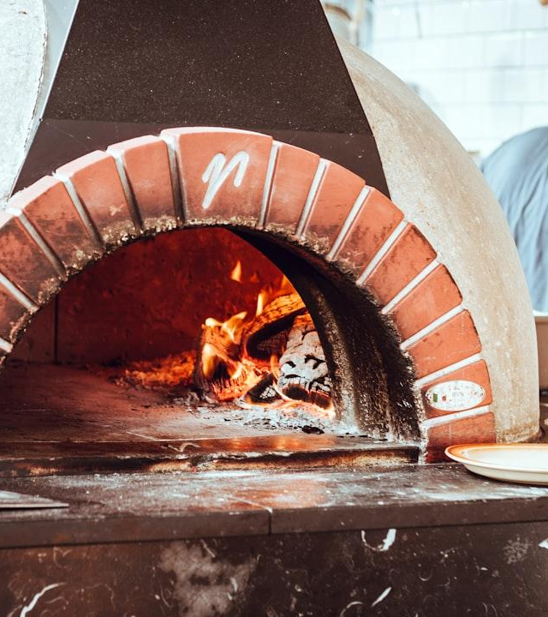
Best and Worst Sellers
Top-selling pizzas: Classic Deluxe, Chicken Pizza, Pepperoni Pizza.
Least-selling pizzas: Soppressata, Brie Carre, Chicken Pesto.
Photo: man standing beside fireplace facing backwards
Photo by Cathal Mac an Bheatha
Powered by Unsplash

Slide 9
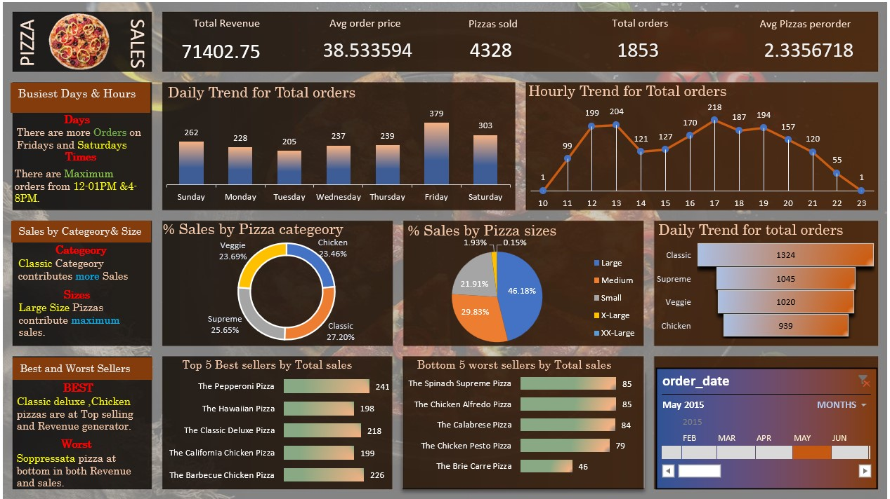
Dashboard:

Slide 10
Dax Queries:
Added total_oders column by writing =1/COUNTIF(B:B,[@[order_id]])
Added order_day column by writing =TEXT([@[order_date]],"dddd")

Slide 11
Conclusion & Insights
Friday and Saturday are the busiest days.
Large pizzas are the most popular size.
Classic pizzas generate the most revenue.
Optimizing stock for peak hours can boost sales.

